Slide 1
EXCEPTION HANDLING IN PYTHON
• What is Exception handling
• Exception handling by Try-Except-else
• Exception handling by Try-Finally
• Raising an Exception
• Python defined exception
• User defined exception
FILES HANDLING
• Python files and directory manipulation
• Open files
• Read files
• Write files
• Append files

Slide 2
EXCEPTION HANDLING:

Slide 3
What is Exception handling:
All code is written to execute with certain conditions holding at runtime. If these conditions do not hold, then it might very well be the case that the code does not perform the correct actions.
2. Handling exceptions that occur at runtime is very important.

Slide 4
Errors and Exception in Python:
Errors can be of two types:
Syntax errors
Errors which are encountered at runtime (Exceptions)
Syntax Errors:
Errors caused by not following the proper structure (syntax) of the language are called syntax or parsing errors.
For eg:
for I in range (0,5)
print (i)
The error is caused by (or at least detected at) the token preceding the arrow.

Slide 5
Exceptions:
Your code may be syntactically correct but it may happen that during run-time Python encounters something which it can't handle, then it raises an exception. For example, dividing a number by zero or trying to write to a file which is read-only.
Some Python Built in Exceptions:
ZeroDivisionError
AssertionError
ImportError
IndexError
KeyboardInterruptError
KeyError
NameError
TypeError
ValueError

Slide 6
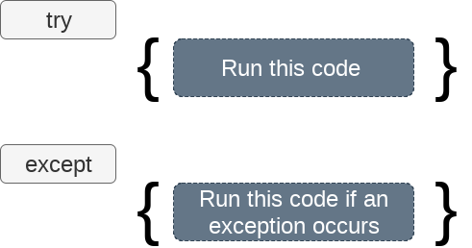
Handling an Exception:
Python handles exceptions using try and except blocks. In try block you can write the code which is suspicious to raise an exception, and in except block, you can write the code which will handle this exception.
If an exception occurs during execution of the try clause, the rest of the clause is skipped. Then if its type matches the exception named after the except keyword, the except clause is executed, and then execution continues after the try statement.

Slide 7
Except Clause with multiple Exceptions:
If you want to write a single except clause to handle multiple exceptions,this can be achieved by writing names of exception classes in except clause seperated by comma.
try:
#block of code
except Exception1:
#block of code
except Exception2:
#block of code
try:
#block of code
except (<Exception 1>,<Exception 2>,<Exception 3>,...<Exception n>)
#block of code
else:
#block of code

Slide 8
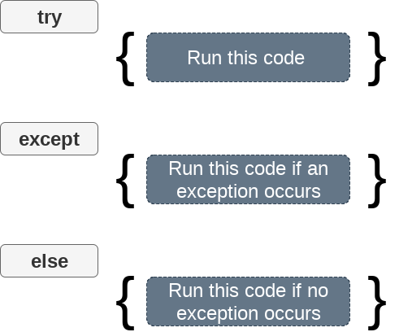
Try ... except ... else clause :
The else clause in a try , except statement must follow all except clauses, and is useful for code that must be executed if the try clause does not raise an exception.

Slide 9
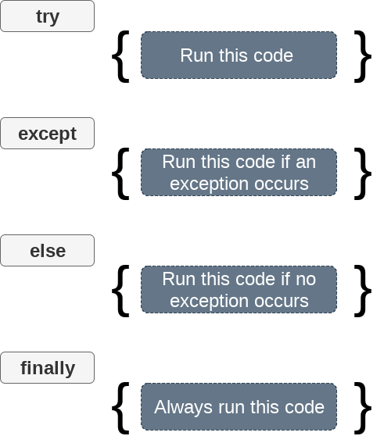
Try-Finally clause:
In case if there is any code which you want to be executed, whether exception occurs or not, then that code can be placed inside the finally block.
2) When an exception occurs, the control immediately goes to finally block and all the lines in finally block gets executed first. After that the control goes to except block to handle exception.

Slide 10
Raising Exception:
To raise an exception, raise statement is used. The exception class name follows it.
An exception can be provided with a value that can be given in the parenthesis.

Slide 11
Assert Statement:
When it encounters an assert statement, Python evaluates the accompanying expression, which is hopefully true. If the expression is false, Python raises an AssertionError exception.
The syntax for assert is −
assert Expression ‘Message to be printed if condition is false’

Slide 12
FILE HANDLING WITH PYTHON

Slide 13
There are various file operations in python:
Before you can read or write a file, you have to open it using Python's built-in open() function. This function creates a file object, which would be utilized to call other support methods associated with it.
Syntax
file object = open(file_name(path if file is not in the same directory as python) , access_mode)

Slide 14
List of different modes of opening a file:
‘r’ : Opens a file for reading only
‘rb’ : Opens a file for reading only in binary format
‘r+’ : Opens a file for both reading and writing.
‘rb+’: Opens a file for both reading and writing in binary format.
‘w’ : Opens a file for writing only.
‘wb’ : Opens a file for writing only in binary format.
‘w+’ : Opens a file for both writing and reading.
‘wb+’ : Opens a file for both writing and reading in binary format.
‘a’ : Opens a file for appending. The file pointer is at the end of the file if the file exists.
‘ab’ : Opens a file for appending in binary format. The file pointer is at the end of the file if the file exists.
‘a+’ : Opens a file for both appending and reading.
‘ab+’ Opens a file for both appending and reading in binary format. The file pointer is at the end of the file if the file exists.

Slide 15
File Object Attributes: (https://www.geeksforgeeks.org/file-objects-python/)
1) read([size])
2) readline([size])
3) write(string)
4) tell()
5) close()
6) file.mode
7) readlines()
8) seek()
9) rename(current file name, new file name)
10) remove(file name)

Slide 16
Opening a File:
To open a file we use open() function.
We have to pass the file path and the mode as arguments
If the file is not present in the python directory you have to specify the complete path.
We can also use with block to open a file as it take care of the file closing after the code in the with block is executed.
Syntax:
1) f = open("test.txt",'w') or
2) with open ("test.txt",'w') as wf:
(block of code to be executed)

Slide 17
Reading a file:
To read a file in Python, we must open the file in reading mode.
There are various methods available for this purpose. Read(), readline(), readlines().
We can use the read(size) method to read in size number of data. If size parameter is not specified, it reads and returns up to the end of the file.
We can read a file line-by-line using a for loop.
for line in f:
... print(line, end = '')
The print() end parameter to avoid two newlines when printing.
with open(r“test.txt",'r') as rf:
Lines = rf.read()
print (Lines)

Slide 18
Writing a file:
In order to write into a file in Python, we need to open it in write 'w', append 'a' or ‘r+’ mode.
We need to be careful with the 'w' mode as it will overwrite into the file if it already exists. All previous data are erased.
Appending mode ‘a’, which is used to add new data to the end of the file; that is new information is automatically amended to the end
Writing a string or sequence of bytes (for binary files) is done using write() method. This method returns the number of characters written to the file.
Syntax:
with open("test.txt",'w’) as f:
f.write("my first file")

Slide 19
Examples:
Writing a text file
Copying the contents of the text file from one file to other.
Copying an image

Slide 20
Appending a file:
Appending mode ‘a’, which is used to add new data to the end of the file; that is new information is automatically amended to the end
Syntax:
file = open('test.txt','a')
file.write("This will add this line")
file.close()

